Slide 1
Graphs- Shortest Paths
3rd Grade
College of Computer Science and Information Technology
Department of Computer Science
Data Structures
Lecture 8
Instructor: Ghazwan Abdulnabi Al-Ali
University of Basrah, Iraq

Slide 2
Dijkstra’s algorithm
Dijkstra's algorithm - is a solution to the single-source shortest path problem in graph theory.
Works on both directed and undirected graphs. However, all edges must have nonnegative weights.
Approach: Greedy
Input: Weighted graph G={E,V} and source vertex v∈V, such that all edge weights are nonnegative
Output: Lengths of shortest paths (or the shortest paths themselves) from a given source vertex v∈V to all other vertices

Slide 3
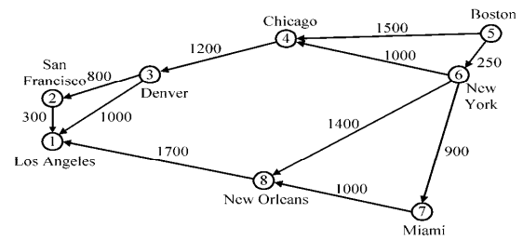
EX: Dijkstra’s algorithm

Slide 4
Solution
Find the minimum vertices.
 | 1 | 2 | 3 | 4 | 5 | 6 | 7 | 8
1 | 0
2
3
4
5
6
7
8

Slide 5
Solution Cont.
Find the minimum vertices.
 | 1 | 2 | 3 | 4 | 5 | 6 | 7 | 8
1 | 0
2 | 300 | 0
3
4
5
6
7
8

Slide 6
Solution Cont.
Find the minimum vertices.
 | 1 | 2 | 3 | 4 | 5 | 6 | 7 | 8
1 | 0
2 | 300 | 0
3 | 1000 | 800 | 0
4
5
6
7
8

Slide 7
Solution Cont.
Find the minimum vertices.
 | 1 | 2 | 3 | 4 | 5 | 6 | 7 | 8
1 | 0
2 | 300 | 0
3 | 1000 | 800 | 0
4 |  |  | 1200 | 0
5
6
7
8

Slide 8
Solution Cont.
Find the minimum vertices.
 | 1 | 2 | 3 | 4 | 5 | 6 | 7 | 8
1 | 0
2 | 300 | 0
3 | 1000 | 800 | 0
4 |  |  | 1200 | 0
5 |  |  |  | 1500 | 0 | 250
6
7
8

Slide 9
Solution Cont.
Find the minimum vertices.
 | 1 | 2 | 3 | 4 | 5 | 6 | 7 | 8
1 | 0
2 | 300 | 0
3 | 1000 | 800 | 0
4 |  |  | 1200 | 0
5 |  |  |  | 1500 | 0 | 250
6 |  |  |  | 1000 |  | 0 | 900 | 1400
7
8

Slide 10
Solution Cont.
Find the minimum vertices.
 | 1 | 2 | 3 | 4 | 5 | 6 | 7 | 8
1 | 0
2 | 300 | 0
3 | 1000 | 800 | 0
4 |  |  | 1200 | 0
5 |  |  |  | 1500 | 0 | 250
6 |  |  |  | 1000 |  | 0 | 900 | 1400
7 |  |  |  |  |  |  | 0 | 1000
8

Slide 11
Solution Cont.
Find the minimum vertices.
 | 1 | 2 | 3 | 4 | 5 | 6 | 7 | 8
1 | 0
2 | 300 | 0
3 | 1000 | 800 | 0
4 |  |  | 1200 | 0
5 |  |  |  | 1500 | 0 | 250
6 |  |  |  | 1000 |  | 0 | 900 | 1400
7 |  |  |  |  |  |  | 0 | 1000
8 | 1700 |  |  |  |  |  |  | 0

Slide 12
Solution Cont.
Find the minimum vertices.
 | 1 | 2 | 3 | 4 | 5 | 6 | 7 | 8
1 | 0
2 | 300 | 0
3 | 1000 | 800 | 0
4 |  |  | 1200 | 0
5 |  |  |  | 1500 | 0 | 250
6 |  |  |  | 1000 |  | 0 | 900 | 1400
7 |  |  |  |  |  |  | 0 | 1000
8 | 1700 |  |  |  |  |  |  | 0
distance[6] is minimum
We will start from the vertex 6

Slide 13
Solution: Dijkstra’s algorithm
Iteration | s | Selected | 1 | 2 | 3 | 4 | 5 | 6 | 7 | 8
initial
1 | 5 |  | +∞ | +∞ | +∞ | 1500 | 0 | 250 | +∞ | +∞
2 | 5,6 | 7 | +∞ | +∞ | +∞ | 1250 | 0 | 250 | 1150 | 1650
3 | 5,6,7 | 4 | +∞ | +∞ | +∞ | 1250 | 0 | 250 | 1150 | 1650
4 | 5,6,7,4 | 8 | +∞ | +∞ | 2450 | 1250 | 0 | 250 | 1150 | 1650
5 | 5,6,7,4,8 | 3 | 3250 |  | 2450 | 1250 | 0 | 250 | 1150 | 1650
6 | 5,6,7,4,8,3 | 2 | 3250 | 3250 | 2450 | 1250 | 0 | 250 | 1150 | 1650
 | 5,6,7,4,8,3,2 |  | 3250 | 3250 | 2450 | 1250 | 0 | 250 | 1150 | 1650
distance[6] is minimum

Slide 14
Solution: Dijkstra’s algorithm
select min vertex
Iteration | s | Selected | 1 | 2 | 3 | 4 | 5 | 6 | 7 | 8
initial
1 | 5 |  | +∞ | +∞ | +∞ | 1500 | 0 | 250 | +∞ | +∞
2 | 5,6 | 7 | +∞ | +∞ | +∞ | 1250 | 0 | 250 | 1150 | 1650
3 | 5,6,7 | 4 | +∞ | +∞ | +∞ | 1250 | 0 | 250 | 1150 | 1650
4 | 5,6,7,4 | 8 | +∞ | +∞ | 2450 | 1250 | 0 | 250 | 1150 | 1650
5 | 5,6,7,4,8 | 3 | 3250 |  | 2450 | 1250 | 0 | 250 | 1150 | 1650
6 | 5,6,7,4,8,3 | 2 | 3250 | 3250 | 2450 | 1250 | 0 | 250 | 1150 | 1650
 | 5,6,7,4,8,3,2 |  | 3250 | 3250 | 2450 | 1250 | 0 | 250 | 1150 | 1650
distance[6] is minimum

Slide 15
Solution: Dijkstra’s algorithm
select min vertex
Iteration | s | Selected | 1 | 2 | 3 | 4 | 5 | 6 | 7 | 8
initial
1 | 5 |  | +∞ | +∞ | +∞ | 1500 | 0 | 250 | +∞ | +∞
2 | 5,6 | 7 | +∞ | +∞ | +∞ | 1250 | 0 | 250 | 1150 | 1650
3 | 5,6,7 | 4 | +∞ | +∞ | +∞ | 1250 | 0 | 250 | 1150 | 1650
4 | 5,6,7,4 | 8 | +∞ | +∞ | 2450 | 1250 | 0 | 250 | 1150 | 1650
5 | 5,6,7,4,8 | 3 | 3250 |  | 2450 | 1250 | 0 | 250 | 1150 | 1650
6 | 5,6,7,4,8,3 | 2 | 3250 | 3250 | 2450 | 1250 | 0 | 250 | 1150 | 1650
 | 5,6,7,4,8,3,2 |  | 3250 | 3250 | 2450 | 1250 | 0 | 250 | 1150 | 1650
distance[6] is minimum

Slide 16
Solution: Dijkstra’s algorithm
Iteration | s | Selected | 1 | 2 | 3 | 4 | 5 | 6 | 7 | 8
initial
1 | 5 | 6 | +∞ | +∞ | +∞ | 1500 | 0 | 250 | +∞ | +∞
2 | 5,6 |  | +∞ | +∞ | +∞ | 5+4= 1250 | 0 | 250 | 5+7= 1150 | 5+8= 1650
3 | 5,6,7 | 4 | +∞ | +∞ | +∞ | 1250 | 0 | 250 | 1150 | 1650
4 | 5,6,7,4 | 8 | +∞ | +∞ | 2450 | 1250 | 0 | 250 | 1150 | 1650
5 | 5,6,7,4,8 | 3 | 3250 |  | 2450 | 1250 | 0 | 250 | 1150 | 1650
6 | 5,6,7,4,8,3 | 2 | 3250 | 3250 | 2450 | 1250 | 0 | 250 | 1150 | 1650
 | 5,6,7,4,8,3,2 |  | 3250 | 3250 | 2450 | 1250 | 0 | 250 | 1150 | 1650
4=(1500 or 1250)=1250
distance[6] is minimum

Slide 17
Solution: Dijkstra’s algorithm
Iteration | s | Selected | 1 | 2 | 3 | 4 | 5 | 6 | 7 | 8
initial
1 | 5 | 6 | +∞ | +∞ | +∞ | 1500 | 0 | 250 | +∞ | +∞
2 | 5,6 |  | +∞ | +∞ | +∞ | 1250 | 0 | 250 | 1150 | 1650
3 | 5,6,7 | 4 | +∞ | +∞ | +∞ | 1250 | 0 | 250 | 1150 | 1650
4 | 5,6,7,4 | 8 | +∞ | +∞ | 2450 | 1250 | 0 | 250 | 1150 | 1650
5 | 5,6,7,4,8 | 3 | 3250 |  | 2450 | 1250 | 0 | 250 | 1150 | 1650
6 | 5,6,7,4,8,3 | 2 | 3250 | 3250 | 2450 | 1250 | 0 | 250 | 1150 | 1650
 | 5,6,7,4,8,3,2 |  | 3250 | 3250 | 2450 | 1250 | 0 | 250 | 1150 | 1650
select min vertex
distance[6] is minimum

Slide 18
Solution: Dijkstra’s algorithm
Iteration | s | Selected | 1 | 2 | 3 | 4 | 5 | 6 | 7 | 8
initial
1 | 5 | 6 | +∞ | +∞ | +∞ | 1500 | 0 | 250 | +∞ | +∞
2 | 5,6 | 7 | +∞ | +∞ | +∞ | 1250 | 0 | 250 | 1150 | 1650
3 | 5,6,7 | 4 | +∞ | +∞ | +∞ | 1250 | 0 | 250 | 1150 | 1650
4 | 5,6,7,4 | 8 | +∞ | +∞ | 2450 | 1250 | 0 | 250 | 1150 | 1650
5 | 5,6,7,4,8 | 3 | 3250 |  | 2450 | 1250 | 0 | 250 | 1150 | 1650
6 | 5,6,7,4,8,3 | 2 | 3250 | 3250 | 2450 | 1250 | 0 | 250 | 1150 | 1650
 | 5,6,7,4,8,3,2 |  | 3250 | 3250 | 2450 | 1250 | 0 | 250 | 1150 | 1650
select min vertex
distance[6] is minimum

Slide 19
Solution: Dijkstra’s algorithm
Iteration | s | Selected | 1 | 2 | 3 | 4 | 5 | 6 | 7 | 8
initial
1 | 5 | 6 | +∞ | +∞ | +∞ | 1500 | 0 | 250 | +∞ | +∞
2 | 5,6 | 7 | +∞ | +∞ | +∞ | 1250 | 0 | 250 | 1150 | 1650
3 | 5,6,7 |  | +∞ | +∞ | +∞ | 1250 | 0 | 250 | 1150 | 1650
4 | 5,6,7,4 | 8 | +∞ | +∞ | 2450 | 1250 | 0 | 250 | 1150 | 1650
5 | 5,6,7,4,8 | 3 | 3250 |  | 2450 | 1250 | 0 | 250 | 1150 | 1650
6 | 5,6,7,4,8,3 | 2 | 3250 | 3250 | 2450 | 1250 | 0 | 250 | 1150 | 1650
 | 5,6,7,4,8,3,2 |  | 3250 | 3250 | 2450 | 1250 | 0 | 250 | 1150 | 1650
distance[6] is minimum
(5,6,7,8)=(250 + 900 + 1000) = 2150 > 1650

Slide 20
Solution: Dijkstra’s algorithm
Iteration | s | Selected | 1 | 2 | 3 | 4 | 5 | 6 | 7 | 8
initial
1 | 5 | 6 | +∞ | +∞ | +∞ | 1500 | 0 | 250 | +∞ | +∞
2 | 5,6 | 7 | +∞ | +∞ | +∞ | 1250 | 0 | 250 | 1150 | 1650
3 | 5,6,7 |  | +∞ | +∞ | +∞ | 1250 | 0 | 250 | 1150 | 1650
4 | 5,6,7,4 | 8 | +∞ | +∞ | 2450 | 1250 | 0 | 250 | 1150 | 1650
5 | 5,6,7,4,8 | 3 | 3250 |  | 2450 | 1250 | 0 | 250 | 1150 | 1650
6 | 5,6,7,4,8,3 | 2 | 3250 | 3250 | 2450 | 1250 | 0 | 250 | 1150 | 1650
 | 5,6,7,4,8,3,2 |  | 3250 | 3250 | 2450 | 1250 | 0 | 250 | 1150 | 1650
select min vertex
distance[6] is minimum

Slide 21
Solution: Dijkstra’s algorithm
Iteration | s | Selected | 1 | 2 | 3 | 4 | 5 | 6 | 7 | 8
initial
1 | 5 | 6 | +∞ | +∞ | +∞ | 1500 | 0 | 250 | +∞ | +∞
2 | 5,6 | 7 | +∞ | +∞ | +∞ | 1250 | 0 | 250 | 1150 | 1650
3 | 5,6,7 | 4 | +∞ | +∞ | +∞ | 1250 | 0 | 250 | 1150 | 1650
4 | 5,6,7,4 | 8 | +∞ | +∞ | 2450 | 1250 | 0 | 250 | 1150 | 1650
5 | 5,6,7,4,8 | 3 | 3250 |  | 2450 | 1250 | 0 | 250 | 1150 | 1650
6 | 5,6,7,4,8,3 | 2 | 3250 | 3250 | 2450 | 1250 | 0 | 250 | 1150 | 1650
 | 5,6,7,4,8,3,2 |  | 3250 | 3250 | 2450 | 1250 | 0 | 250 | 1150 | 1650
distance[6] is minimum

Slide 22
Solution: Dijkstra’s algorithm
Iteration | s | Selected | 1 | 2 | 3 | 4 | 5 | 6 | 7 | 8
initial
1 | 5 | 6 | +∞ | +∞ | +∞ | 1500 | 0 | 250 | +∞ | +∞
2 | 5,6 | 7 | +∞ | +∞ | +∞ | 1250 | 0 | 250 | 1150 | 1650
3 | 5,6,7 | 4 | +∞ | +∞ | +∞ | 1250 | 0 | 250 | 1150 | 1650
4 | 5,6,7,4 |  | +∞ | +∞ | 2450 | 1250 | 0 | 250 | 1150 | 1650
5 | 5,6,7,4,8 | 3 | 3250 |  | 2450 | 1250 | 0 | 250 | 1150 | 1650
6 | 5,6,7,4,8,3 | 2 | 3250 | 3250 | 2450 | 1250 | 0 | 250 | 1150 | 1650
 | 5,6,7,4,8,3,2 |  | 3250 | 3250 | 2450 | 1250 | 0 | 250 | 1150 | 1650
select min vertex
distance[6] is minimum

Slide 23
Solution: Dijkstra’s algorithm
Iteration | s | Selected | 1 | 2 | 3 | 4 | 5 | 6 | 7 | 8
initial
1 | 5 | 6 | +∞ | +∞ | +∞ | 1500 | 0 | 250 | +∞ | +∞
2 | 5,6 | 7 | +∞ | +∞ | +∞ | 1250 | 0 | 250 | 1150 | 1650
3 | 5,6,7 | 4 | +∞ | +∞ | +∞ | 1250 | 0 | 250 | 1150 | 1650
4 | 5,6,7,4 | 8 | +∞ | +∞ | 2450 | 1250 | 0 | 250 | 1150 | 1650
5 | 5,6,7,4,8 | 3 | 3250 |  | 2450 | 1250 | 0 | 250 | 1150 | 1650
6 | 5,6,7,4,8,3 | 2 | 3250 | 3250 | 2450 | 1250 | 0 | 250 | 1150 | 1650
 | 5,6,7,4,8,3,2 |  | 3250 | 3250 | 2450 | 1250 | 0 | 250 | 1150 | 1650
distance[6] is minimum

Slide 24
Solution: Dijkstra’s algorithm
Iteration | s | Selected | 1 | 2 | 3 | 4 | 5 | 6 | 7 | 8
initial
1 | 5 | 6 | +∞ | +∞ | +∞ | 1500 | 0 | 250 | +∞ | +∞
2 | 5,6 | 7 | +∞ | +∞ | +∞ | 1250 | 0 | 250 | 1150 | 1650
3 | 5,6,7 | 4 | +∞ | +∞ | +∞ | 1250 | 0 | 250 | 1150 | 1650
4 | 5,6,7,4 | 8 | +∞ | +∞ | 2450 | 1250 | 0 | 250 | 1150 | 1650
5 | 5,6,7,4,8 |  | 3,350 | +∞ | 2450 | 1250 | 0 | 250 | 1150 | 1650
6 | 5,6,7,4,8,3 | 2 | 3250 | 3250 | 2450 | 1250 | 0 | 250 | 1150 | 1650
 | 5,6,7,4,8,3,2 |  | 3250 | 3250 | 2450 | 1250 | 0 | 250 | 1150 | 1650
distance[6] is minimum
select min vertex
(5,6,7,8,1)=(250+900+1000+1700)= 3,850 X
(5,6,8,1)=(250+1400+1700)= 3,350

Slide 25
Solution: Dijkstra’s algorithm
Iteration | s | Selected | 1 | 2 | 3 | 4 | 5 | 6 | 7 | 8
initial
1 | 5 | 6 | +∞ | +∞ | +∞ | 1500 | 0 | 250 | +∞ | +∞
2 | 5,6 | 7 | +∞ | +∞ | +∞ | 1250 | 0 | 250 | 1150 | 1650
3 | 5,6,7 | 4 | +∞ | +∞ | +∞ | 1250 | 0 | 250 | 1150 | 1650
4 | 5,6,7,4 | 8 | +∞ | +∞ | 2450 | 1250 | 0 | 250 | 1150 | 1650
5 | 5,6,7,4,8 | 3 | 3,350 | +∞ | 2450 | 1250 | 0 | 250 | 1150 | 1650
6 | 5,6,7,4,8,3 | 2 | 3250 | 3250 | 2450 | 1250 | 0 | 250 | 1150 | 1650
 | 5,6,7,4,8,3,2 |  | 3250 | 3250 | 2450 | 1250 | 0 | 250 | 1150 | 1650
distance[6] is minimum
(5,7,8,1)=(250+900+1000+1700)= 3,850
(5,6,8,1)=(250+1400+1700)= 3,350

Slide 26
Solution: Dijkstra’s algorithm
Iteration | s | Selected | 1 | 2 | 3 | 4 | 5 | 6 | 7 | 8
initial
1 | 5 | 6 | +∞ | +∞ | +∞ | 1500 | 0 | 250 | +∞ | +∞
2 | 5,6 | 7 | +∞ | +∞ | +∞ | 1250 | 0 | 250 | 1150 | 1650
3 | 5,6,7 | 4 | +∞ | +∞ | +∞ | 1250 | 0 | 250 | 1150 | 1650
4 | 5,6,7,4 | 8 | +∞ | +∞ | 2450 | 1250 | 0 | 250 | 1150 | 1650
5 | 5,6,7,4,8 | 3 | 3,350 | +∞ | 2450 | 1250 | 0 | 250 | 1150 | 1650
6 | 5,6,7,4,8,3 | 2 | 3,350 | 3250 | 2450 | 1250 | 0 | 250 | 1150 | 1650
 | 5,6,7,4,8,3,2 |  | 3250 | 3250 | 2450 | 1250 | 0 | 250 | 1150 | 1650
distance[6] is minimum
(5,6,,4,3,2)=(250+1000+1200+800)=3,250
(5,6,4,3,1)=(250+1000+1200+100)= 3,450 X

Slide 27
Solution: Dijkstra’s algorithm
Iteration | s | Selected | 1 | 2 | 3 | 4 | 5 | 6 | 7 | 8
initial
1 | 5 | 6 | +∞ | +∞ | +∞ | 1500 | 0 | 250 | +∞ | +∞
2 | 5,6 | 7 | +∞ | +∞ | +∞ | 1250 | 0 | 250 | 1150 | 1650
3 | 5,6,7 | 4 | +∞ | +∞ | +∞ | 1250 | 0 | 250 | 1150 | 1650
4 | 5,6,7,4 | 8 | +∞ | +∞ | 2450 | 1250 | 0 | 250 | 1150 | 1650
5 | 5,6,7,4,8 | 3 | 3,350 | +∞ | 2450 | 1250 | 0 | 250 | 1150 | 1650
6 | 5,6,7,4,8,3 | 2 | 3,350 | 3250 | 2450 | 1250 | 0 | 250 | 1150 | 1650
 | 5,6,7,4,8,3,2 |  | 3250 | 3250 | 2450 | 1250 | 0 | 250 | 1150 | 1650
distance[6] is minimum
(5,6,,4,3,2)=(250+1000+1200+800)=3,250
(5,6,4,3,1)= )=(250+1000+1200+100)= 3,450 X

Slide 28
Solution: Dijkstra’s algorithm
Iteration | s | Selected | 1 | 2 | 3 | 4 | 5 | 6 | 7 | 8
initial
1 | 5 | 6 | +∞ | +∞ | +∞ | 1500 | 0 | 250 | +∞ | +∞
2 | 5,6 | 7 | +∞ | +∞ | +∞ | 1250 | 0 | 250 | 1150 | 1650
3 | 5,6,7 | 4 | +∞ | +∞ | +∞ | 1250 | 0 | 250 | 1150 | 1650
4 | 5,6,7,4 | 8 | +∞ | +∞ | 2450 | 1250 | 0 | 250 | 1150 | 1650
5 | 5,6,7,4,8 | 3 | 3,350 | +∞ | 2450 | 1250 | 0 | 250 | 1150 | 1650
6 | 5,6,7,4,8,3 | 2 | 3,350 | 3250 | 2450 | 1250 | 0 | 250 | 1150 | 1650
 | 5,6,7,4,8,3,2 |  | 3,350 | 3250 | 2450 | 1250 | 0 | 250 | 1150 | 1650
distance[6] is minimum
(5,6,,4,3,2,1)=(250+1000+1200+800+300)= 3,550 X

Slide 29
Solution: Dijkstra’s algorithm
Iteration | s | Selected | 1 | 2 | 3 | 4 | 5 | 6 | 7 | 8
initial
1 | 5 | 6 | +∞ | +∞ | +∞ | 1500 | 0 | 250 | +∞ | +∞
2 | 5,6 | 7 | +∞ | +∞ | +∞ | 1250 | 0 | 250 | 1150 | 1650
3 | 5,6,7 | 4 | +∞ | +∞ | +∞ | 1250 | 0 | 250 | 1150 | 1650
4 | 5,6,7,4 | 8 | +∞ | +∞ | 2450 | 1250 | 0 | 250 | 1150 | 1650
5 | 5,6,7,4,8 | 3 | 3,350 | +∞ | 2450 | 1250 | 0 | 250 | 1150 | 1650
6 | 5,6,7,4,8,3 | 2 | 3,350 | 3250 | 2450 | 1250 | 0 | 250 | 1150 | 1650
 | 5,6,7,4,8,3,2 |  | 3,350 | 3250 | 2450 | 1250 | 0 | 250 | 1150 | 1650
distance[6] is minimum
(5,6,,4,3,2,1)=(250+1000+1200+800+300)= 3,550 X

Slide 30
Floyd’s Algorithm
The problem: find the shortest path between every pair of vertices of a graph
The graph: may contain negative edges but no negative cycles
A representation: a weight matrix where W(i,j)=0 if i=j. W(i,j)=∞ if there is no edge between i and j. W(i,j)=“weight of edge”
Note: we have shown principle of optimality

Slide 31
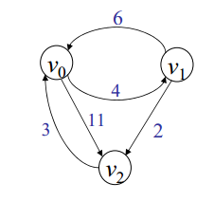
EX:Floyd’s Algorithm

Slide 32
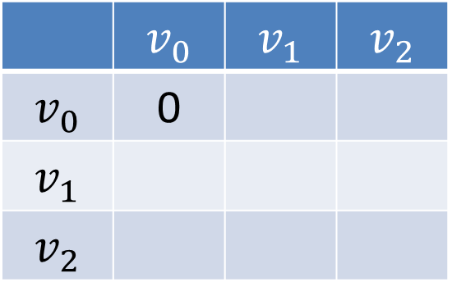
Solution:Floyd’s Algorithm
 | $$v_{0}$$ | $$v_{1}$$ | $$v_{2}$$
$$v_{0}$$ | 0
$$v_{1}$$
$$v_{2}$$

Slide 33
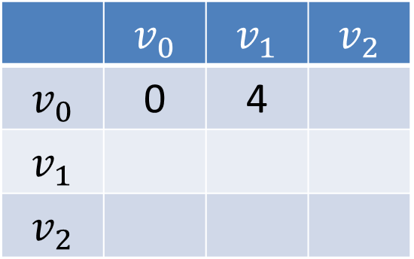
Solution:Floyd’s Algorithm Cont.
 | $$v_{0}$$ | $$v_{1}$$ | $$v_{2}$$
$$v_{0}$$ | 0 | 4
$$v_{1}$$
$$v_{2}$$

Slide 34
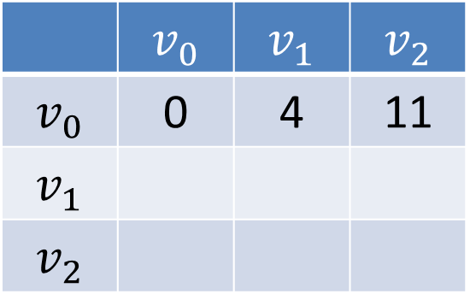
Solution:Floyd’s Algorithm Cont.
 | $$v_{0}$$ | $$v_{1}$$ | $$v_{2}$$
$$v_{0}$$ | 0 | 4 | 11
$$v_{1}$$
$$v_{2}$$

Slide 35
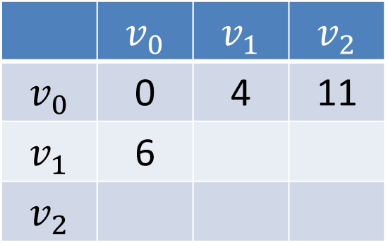
Solution:Floyd’s Algorithm Cont.
 | $$v_{0}$$ | $$v_{1}$$ | $$v_{2}$$
$$v_{0}$$ | 0 | 4 | 11
$$v_{1}$$ | 6
$$v_{2}$$

Slide 36
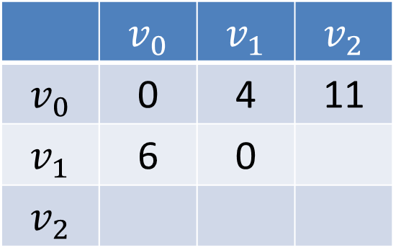
Solution:Floyd’s Algorithm Cont.
 | $$v_{0}$$ | $$v_{1}$$ | $$v_{2}$$
$$v_{0}$$ | 0 | 4 | 11
$$v_{1}$$ | 6 | 0
$$v_{2}$$

Slide 37
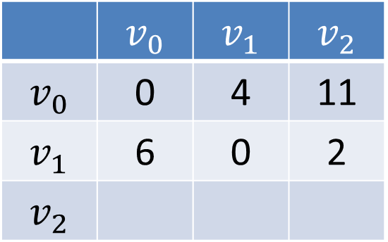
Solution:Floyd’s Algorithm Cont.
 | $$v_{0}$$ | $$v_{1}$$ | $$v_{2}$$
$$v_{0}$$ | 0 | 4 | 11
$$v_{1}$$ | 6 | 0 | 2
$$v_{2}$$

Slide 38
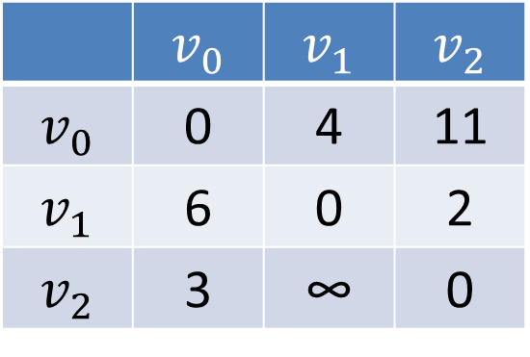
Solution:Floyd’s Algorithm Cont.
 | $$v_{0}$$ | $$v_{1}$$ | $$v_{2}$$
$$v_{0}$$ | 0 | 4 | 11
$$v_{1}$$ | 6 | 0 | 2
$$v_{2}$$ | 3 | ∞ | 0

Slide 39
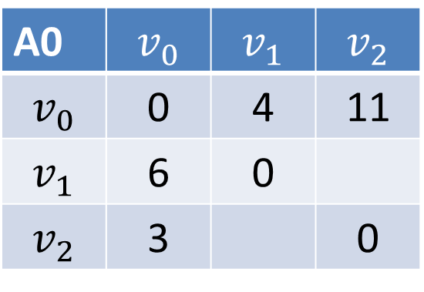
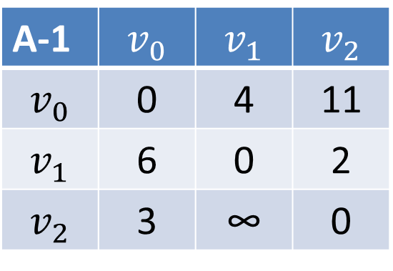
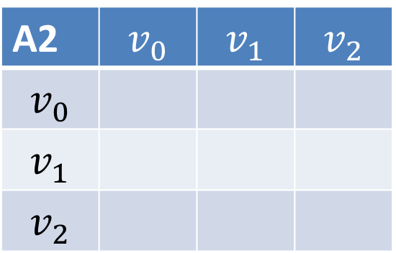
Solution:Floyd’s Algorithm Cont.
$A^{K}$[i,j]=${min⁡(A}^{K−1}$[i,j], $A^{K−1}$[i,k] + $A^{K−1}$[k,j]
K=0
i=1,j=2
A-1 | $$v_{0}$$ | $$v_{1}$$ | $$v_{2}$$
$$v_{0}$$ | 0 | 4 | 11
$$v_{1}$$ | 6 | 0 | 2
$$v_{2}$$ | 3 | ∞ | 0
A0 | $$v_{0}$$ | $$v_{1}$$ | $$v_{2}$$
$$v_{0}$$ | 0 | 4 | 11
$$v_{1}$$ | 6 | 0
$$v_{2}$$ | 3 |  | 0
=min([1,2],[1,0]+[0,2])=
A1 | $$v_{0}$$ | $$v_{1}$$ | $$v_{2}$$
$$v_{0}$$
$$v_{1}$$
$$v_{2}$$
A2 | $$v_{0}$$ | $$v_{1}$$ | $$v_{2}$$
$$v_{0}$$
$$v_{1}$$
$$v_{2}$$

Slide 40
Solution:Floyd’s Algorithm Cont.
$A^{K}$[i,j]=${min⁡(A}^{K−1}$[i,j], $A^{K−1}$[i,k] + $A^{K−1}$[k,j]
K=0
i=1,j=2
A-1 | $$v_{0}$$ | $$v_{1}$$ | $$v_{2}$$
$$v_{0}$$ | 0 | 4 | 11
$$v_{1}$$ | 6 | 0 | 2
$$v_{2}$$ | 3 | ∞ | 0
A0 | $$v_{0}$$ | $$v_{1}$$ | $$v_{2}$$
$$v_{0}$$ | 0 | 4 | 11
$$v_{1}$$ | 6 | 0
$$v_{2}$$ | 3 |  | 0
=min(2,6+11)=2
A1 | $$v_{0}$$ | $$v_{1}$$ | $$v_{2}$$
$$v_{0}$$
$$v_{1}$$
$$v_{2}$$
A2 | $$v_{0}$$ | $$v_{1}$$ | $$v_{2}$$
$$v_{0}$$
$$v_{1}$$
$$v_{2}$$

Slide 41
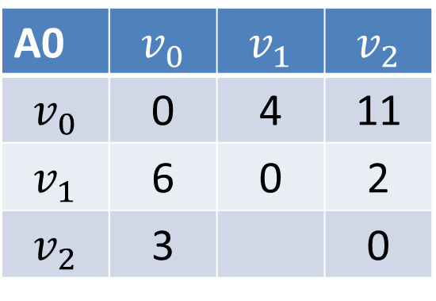
$A^{K}$[i,j]=${min⁡(A}^{K−1}$[i,j], $A^{K−1}$[i,k] + $A^{K−1}$[k,j]
K=0
i=1,j=2
A-1 | $$v_{0}$$ | $$v_{1}$$ | $$v_{2}$$
$$v_{0}$$ | 0 | 4 | 11
$$v_{1}$$ | 6 | 0 | 2
$$v_{2}$$ | 3 | ∞ | 0
A0 | $$v_{0}$$ | $$v_{1}$$ | $$v_{2}$$
$$v_{0}$$ | 0 | 4 | 11
$$v_{1}$$ | 6 | 0 | 2
$$v_{2}$$ | 3 |  | 0
=min(2,17)=2
A1 | $$v_{0}$$ | $$v_{1}$$ | $$v_{2}$$
$$v_{0}$$
$$v_{1}$$
$$v_{2}$$
A2 | $$v_{0}$$ | $$v_{1}$$ | $$v_{2}$$
$$v_{0}$$
$$v_{1}$$
$$v_{2}$$

Slide 42
Solution:Floyd’s Algorithm Cont.
$A^{K}$[i,j]=${min⁡(A}^{K−1}$[i,j], $A^{K−1}$[i,k] + $A^{K−1}$[k,j]
K=0
i=2,j=1
A-1 | $$v_{0}$$ | $$v_{1}$$ | $$v_{2}$$
$$v_{0}$$ | 0 | 4 | 11
$$v_{1}$$ | 6 | 0 | 2
$$v_{2}$$ | 3 | ∞ | 0
A0 | $$v_{0}$$ | $$v_{1}$$ | $$v_{2}$$
$$v_{0}$$ | 0 | 4 | 11
$$v_{1}$$ | 6 | 0 | 2
$$v_{2}$$ | 3 |  | 0
=min([2,1],[2,0]+[0,1])=
A1 | $$v_{0}$$ | $$v_{1}$$ | $$v_{2}$$
$$v_{0}$$
$$v_{1}$$
$$v_{2}$$
A2 | $$v_{0}$$ | $$v_{1}$$ | $$v_{2}$$
$$v_{0}$$
$$v_{1}$$
$$v_{2}$$

Slide 43
Solution:Floyd’s Algorithm Cont.
$A^{K}$[i,j]=${min⁡(A}^{K−1}$[i,j], $A^{K−1}$[i,k] + $A^{K−1}$[k,j]
K=0
i=2,j=1
A-1 | $$v_{0}$$ | $$v_{1}$$ | $$v_{2}$$
$$v_{0}$$ | 0 | 4 | 11
$$v_{1}$$ | 6 | 0 | 2
$$v_{2}$$ | 3 | ∞ | 0
A0 | $$v_{0}$$ | $$v_{1}$$ | $$v_{2}$$
$$v_{0}$$ | 0 | 4 | 11
$$v_{1}$$ | 6 | 0 | 2
$$v_{2}$$ | 3 |  | 0
=min(∞,3+4)=
A1 | $$v_{0}$$ | $$v_{1}$$ | $$v_{2}$$
$$v_{0}$$
$$v_{1}$$
$$v_{2}$$
A2 | $$v_{0}$$ | $$v_{1}$$ | $$v_{2}$$
$$v_{0}$$
$$v_{1}$$
$$v_{2}$$

Slide 44
$A^{K}$[i,j]=${min⁡(A}^{K−1}$[i,j], $A^{K−1}$[i,k] + $A^{K−1}$[k,j]
K=0
i=2,j=1
A-1 | $$v_{0}$$ | $$v_{1}$$ | $$v_{2}$$
$$v_{0}$$ | 0 | 4 | 11
$$v_{1}$$ | 6 | 0 | 2
$$v_{2}$$ | 3 | ∞ | 0
A0 | $$v_{0}$$ | $$v_{1}$$ | $$v_{2}$$
$$v_{0}$$ | 0 | 4 | 11
$$v_{1}$$ | 6 | 0 | 2
$$v_{2}$$ | 3 |  | 0
=min(∞,7)=7
A1 | $$v_{0}$$ | $$v_{1}$$ | $$v_{2}$$
$$v_{0}$$
$$v_{1}$$
$$v_{2}$$
A2 | $$v_{0}$$ | $$v_{1}$$ | $$v_{2}$$
$$v_{0}$$
$$v_{1}$$
$$v_{2}$$

Slide 45
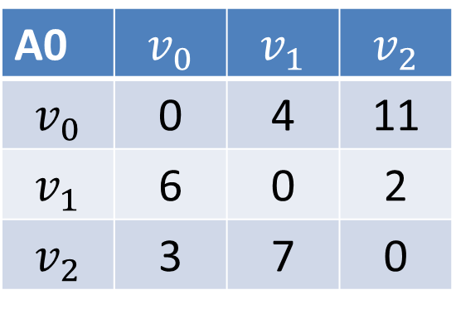
Solution:Floyd’s Algorithm Cont.
$A^{K}$[i,j]=${min⁡(A}^{K−1}$[i,j], $A^{K−1}$[i,k] + $A^{K−1}$[k,j]
K=0
i=2,j=1
A-1 | $$v_{0}$$ | $$v_{1}$$ | $$v_{2}$$
$$v_{0}$$ | 0 | 4 | 11
$$v_{1}$$ | 6 | 0 | 2
$$v_{2}$$ | 3 | ∞ | 0
A0 | $$v_{0}$$ | $$v_{1}$$ | $$v_{2}$$
$$v_{0}$$ | 0 | 4 | 11
$$v_{1}$$ | 6 | 0 | 2
$$v_{2}$$ | 3 | 7 | 0
=min(∞,7)=7
A1 | $$v_{0}$$ | $$v_{1}$$ | $$v_{2}$$
$$v_{0}$$
$$v_{1}$$
$$v_{2}$$
A2 | $$v_{0}$$ | $$v_{1}$$ | $$v_{2}$$
$$v_{0}$$
$$v_{1}$$
$$v_{2}$$

Slide 46
Solution:Floyd’s Algorithm Cont.
$A^{K}$[i,j]=${min⁡(A}^{K−1}$[i,j], $A^{K−1}$[i,k] + $A^{K−1}$[k,j]
K=1
i=?,j=?
A0 | $$v_{0}$$ | $$v_{1}$$ | $$v_{2}$$
$$v_{0}$$ | 0 | 4 | 11
$$v_{1}$$ | 6 | 0 | 2
$$v_{2}$$ | 3 | 7 | 0
=min()=
A1 | $$v_{0}$$ | $$v_{1}$$ | $$v_{2}$$
$$v_{0}$$
$$v_{1}$$
$$v_{2}$$
A2 | $$v_{0}$$ | $$v_{1}$$ | $$v_{2}$$
$$v_{0}$$
$$v_{1}$$
$$v_{2}$$

Slide 47
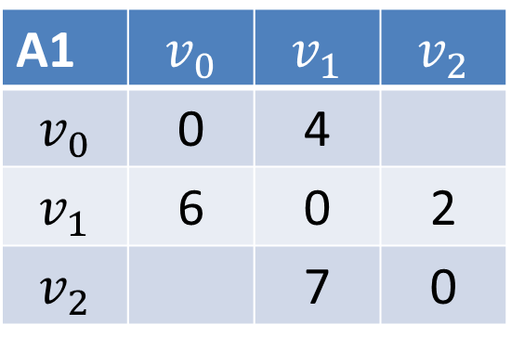
Solution:Floyd’s Algorithm Cont.
$A^{K}$[i,j]=${min⁡(A}^{K−1}$[i,j], $A^{K−1}$[i,k] + $A^{K−1}$[k,j]
K=1
i=?,j=?
A0 | $$v_{0}$$ | $$v_{1}$$ | $$v_{2}$$
$$v_{0}$$ | 0 | 4 | 11
$$v_{1}$$ | 6 | 0 | 2
$$v_{2}$$ | 3 | 7 | 0
=min()
A1 | $$v_{0}$$ | $$v_{1}$$ | $$v_{2}$$
$$v_{0}$$ | 0 | 4
$$v_{1}$$ | 6 | 0 | 2
$$v_{2}$$ |  | 7 | 0
A2 | $$v_{0}$$ | $$v_{1}$$ | $$v_{2}$$
$$v_{0}$$
$$v_{1}$$
$$v_{2}$$

Slide 48
Solution:Floyd’s Algorithm Cont.
$A^{K}$[i,j]=${min⁡(A}^{K−1}$[i,j], $A^{K−1}$[i,k] + $A^{K−1}$[k,j]
K=1
i=0,j=2
A0 | $$v_{0}$$ | $$v_{1}$$ | $$v_{2}$$
$$v_{0}$$ | 0 | 4 | 11
$$v_{1}$$ | 6 | 0 | 2
$$v_{2}$$ | 3 | 7 | 0
=min([0,2],[0,1]+[1,2])=
A1 | $$v_{0}$$ | $$v_{1}$$ | $$v_{2}$$
$$v_{0}$$ | 0 | 4
$$v_{1}$$ | 6 | 0 | 2
$$v_{2}$$ |  | 7 | 0
A2 | $$v_{0}$$ | $$v_{1}$$ | $$v_{2}$$
$$v_{0}$$
$$v_{1}$$
$$v_{2}$$
=min(11,4+2)=

Slide 49
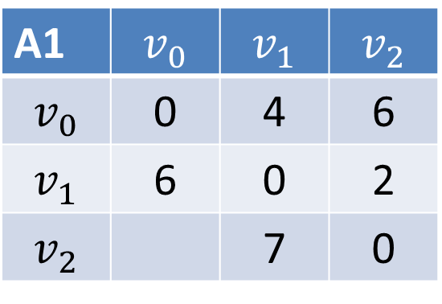
Solution:Floyd’s Algorithm Cont.
$A^{K}$[i,j]=${min⁡(A}^{K−1}$[i,j], $A^{K−1}$[i,k] + $A^{K−1}$[k,j]
K=1
i=0,j=2
A0 | $$v_{0}$$ | $$v_{1}$$ | $$v_{2}$$
$$v_{0}$$ | 0 | 4 | 11
$$v_{1}$$ | 6 | 0 | 2
$$v_{2}$$ | 3 | 7 | 0
A1 | $$v_{0}$$ | $$v_{1}$$ | $$v_{2}$$
$$v_{0}$$ | 0 | 4 | 6
$$v_{1}$$ | 6 | 0 | 2
$$v_{2}$$ |  | 7 | 0
A2 | $$v_{0}$$ | $$v_{1}$$ | $$v_{2}$$
$$v_{0}$$
$$v_{1}$$
$$v_{2}$$
=min(11,6)=6

Slide 50
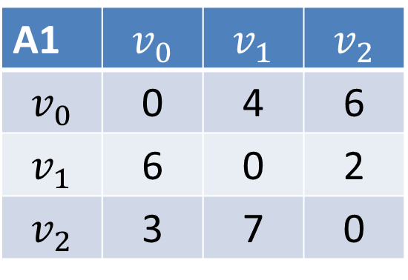
Solution:Floyd’s Algorithm Cont.
$A^{K}$[i,j]=${min⁡(A}^{K−1}$[i,j], $A^{K−1}$[i,k] + $A^{K−1}$[k,j]
K=1
i=2,j=0
A0 | $$v_{0}$$ | $$v_{1}$$ | $$v_{2}$$
$$v_{0}$$ | 0 | 4 | 11
$$v_{1}$$ | 6 | 0 | 2
$$v_{2}$$ | 3 | 7 | 0
=min([2,0],[2,1]+[1,0])=
A1 | $$v_{0}$$ | $$v_{1}$$ | $$v_{2}$$
$$v_{0}$$ | 0 | 4 | 6
$$v_{1}$$ | 6 | 0 | 2
$$v_{2}$$ | 3 | 7 | 0
A2 | $$v_{0}$$ | $$v_{1}$$ | $$v_{2}$$
$$v_{0}$$
$$v_{1}$$
$$v_{2}$$
=min(3,7+6)=3

Slide 51
Solution:Floyd’s Algorithm Cont.
$A^{K}$[i,j]=${min⁡(A}^{K−1}$[i,j], $A^{K−1}$[i,k] + $A^{K−1}$[k,j]
K=2
i=?,j=?
A1 | $$v_{0}$$ | $$v_{1}$$ | $$v_{2}$$
$$v_{0}$$ | 0 | 4 | 6
$$v_{1}$$ | 6 | 0 | 2
$$v_{2}$$ | 3 | 7 | 0
A2 | $$v_{0}$$ | $$v_{1}$$ | $$v_{2}$$
$$v_{0}$$
$$v_{1}$$
$$v_{2}$$

Slide 52
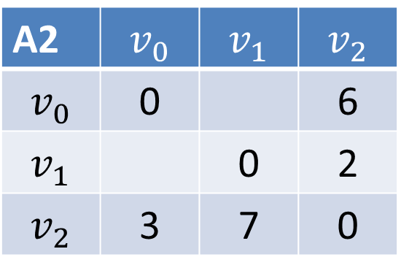
Solution:Floyd’s Algorithm Cont.
$A^{K}$[i,j]=${min⁡(A}^{K−1}$[i,j], $A^{K−1}$[i,k] + $A^{K−1}$[k,j]
K=2
i=0,j=1
=min([0,1],[0,2]+[2,1])=
A1 | $$v_{0}$$ | $$v_{1}$$ | $$v_{2}$$
$$v_{0}$$ | 0 | 4 | 6
$$v_{1}$$ | 6 | 0 | 2
$$v_{2}$$ | 3 | 7 | 0
A2 | $$v_{0}$$ | $$v_{1}$$ | $$v_{2}$$
$$v_{0}$$ | 0 |  | 6
$$v_{1}$$ |  | 0 | 2
$$v_{2}$$ | 3 | 7 | 0
=min(4,6+7)=

Slide 53
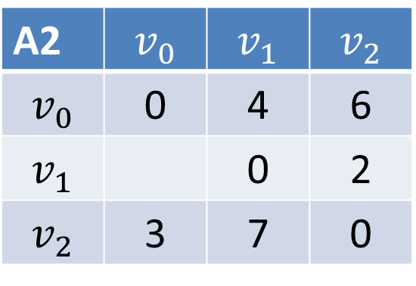
Solution:Floyd’s Algorithm Cont.
$A^{K}$[i,j]=${min⁡(A}^{K−1}$[i,j], $A^{K−1}$[i,k] + $A^{K−1}$[k,j]
K=2
i=0,j=1
=min([0,1],[0,2]+[2,1])=
A1 | $$v_{0}$$ | $$v_{1}$$ | $$v_{2}$$
$$v_{0}$$ | 0 | 4 | 6
$$v_{1}$$ | 6 | 0 | 2
$$v_{2}$$ | 3 | 7 | 0
A2 | $$v_{0}$$ | $$v_{1}$$ | $$v_{2}$$
$$v_{0}$$ | 0 | 4 | 6
$$v_{1}$$ |  | 0 | 2
$$v_{2}$$ | 3 | 7 | 0
=min(4,13)=4

Slide 54
Solution:Floyd’s Algorithm Cont.
$A^{K}$[i,j]=${min⁡(A}^{K−1}$[i,j], $A^{K−1}$[i,k] + $A^{K−1}$[k,j]
K=2
i=1,j=0
=min([1,0],[1,2]+[2,0])=
A1 | $$v_{0}$$ | $$v_{1}$$ | $$v_{2}$$
$$v_{0}$$ | 0 | 4 | 6
$$v_{1}$$ | 6 | 0 | 2
$$v_{2}$$ | 3 | 7 | 0
A2 | $$v_{0}$$ | $$v_{1}$$ | $$v_{2}$$
$$v_{0}$$ | 0 | 4 | 6
$$v_{1}$$ |  | 0 | 2
$$v_{2}$$ | 3 | 7 | 0
=min(6,2+3)=

Slide 55
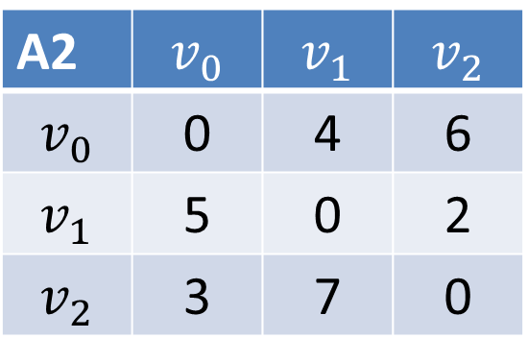
Solution:Floyd’s Algorithm Cont.
$A^{K}$[i,j]=${min⁡(A}^{K−1}$[i,j], $A^{K−1}$[i,k] + $A^{K−1}$[k,j]
K=2
i=1,j=0
=min([1,0],[1,2]+[2,0])=
A1 | $$v_{0}$$ | $$v_{1}$$ | $$v_{2}$$
$$v_{0}$$ | 0 | 4 | 6
$$v_{1}$$ | 6 | 0 | 2
$$v_{2}$$ | 3 | 7 | 0
A2 | $$v_{0}$$ | $$v_{1}$$ | $$v_{2}$$
$$v_{0}$$ | 0 | 4 | 6
$$v_{1}$$ | 5 | 0 | 2
$$v_{2}$$ | 3 | 7 | 0
=min(6,5)=5

Slide 56
Thank You

